Slide 1
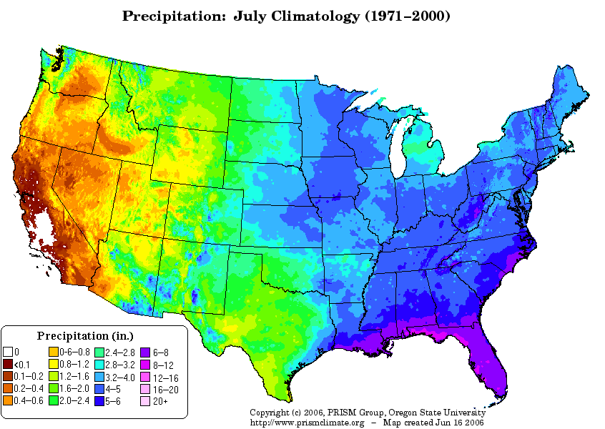
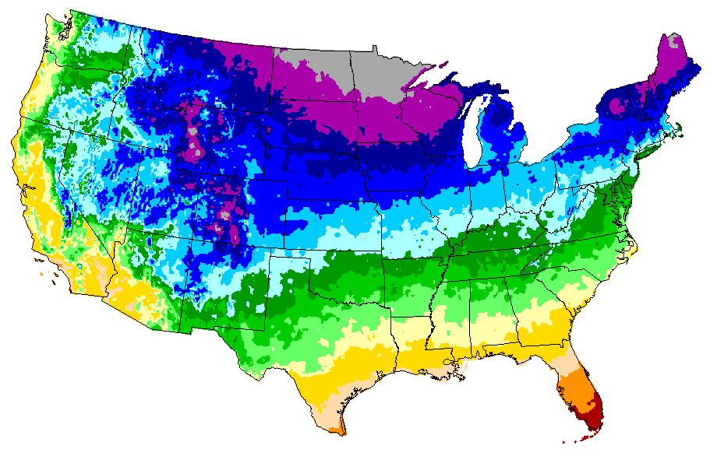
Fig. 1 Precipitation & Temperature Gradients in US
&
Effective Moisture
Precipitation: East-West
Temperature: North-South
C
O
L
D
E
R
DRIER
Interaction of Temperature and Precipitation
Effective Moisture (EM) = Precipitation (P) – Evaporation (E)
If Precipitation remains constant then:
Cooler Climates > EM because E is lower
Warmer Climates < EM because E is higher

Slide 2
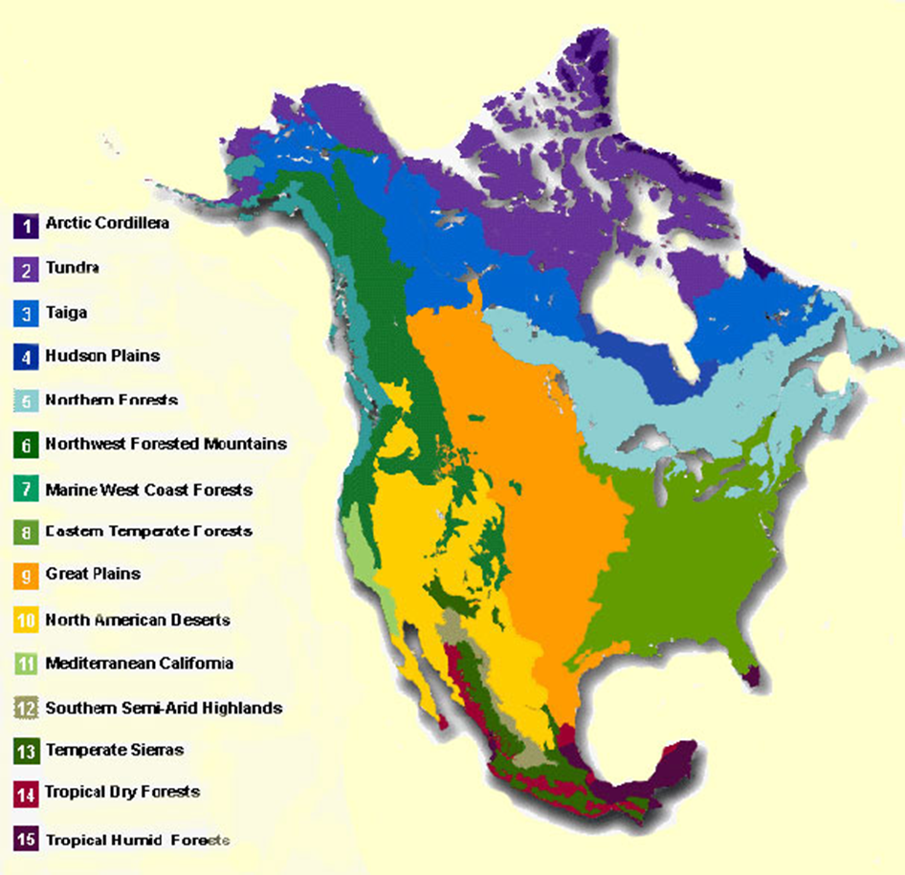
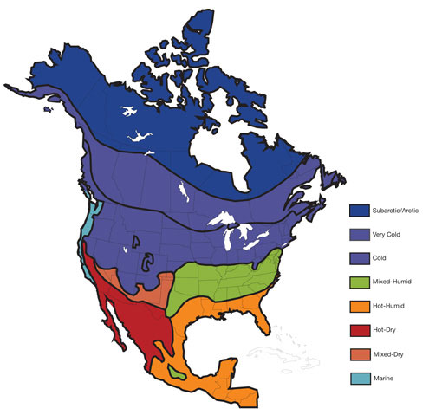
Fig. 2 Biomes of North America
Climate Control?
Biomes
Climate

Slide 3
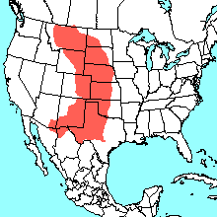
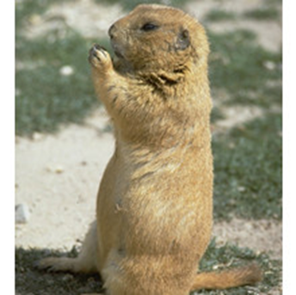
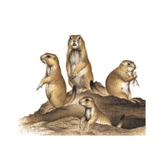
Cautionary Note
Fig. 3 Climate is not the only thing that limits the distribution of organisms
Some Limiting Factors for the Distribution
of
Cynomys ludovicianus (black tail prairie dog)
Precipitation (dry climate)
Soil Moisture (dry but some moisture)
Soil type (not sand)
Soil thickness (1-2 m)
Short grass (no tall grass or forest)
Moderately “large” area (colonial)

Slide 4
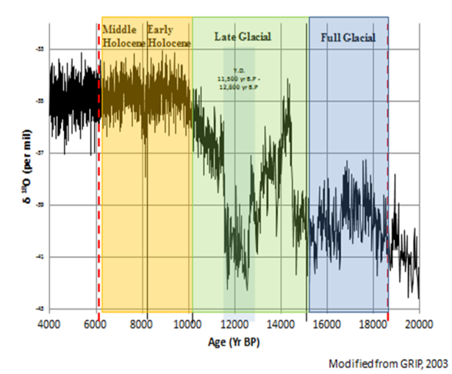
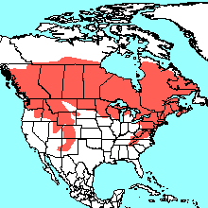
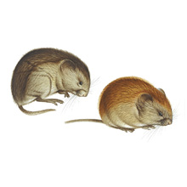
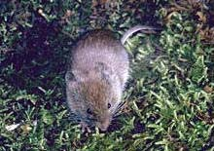
Fig. 4 Testing Hypotheses
Myodes gapperi
(red back vole) today
http://www.mnh.si.edu/mna/
Climate Change
Species
Go to Neotoma Database: http://www.neotomadb.org/
Select Explorer at bottom left
Enlarge North American Map with sliding scale at upper left
Select modern distribution (red polygon at top) and enter species name
Hypothesis: If the climate is colder from 15,000 to 20,000 years ago, then Myodes gapperi should occur farther to the: south, north, east, or west (select one and test hypothesis)
Open search form (binoculars) at top left and enter species name (Myodes gapperi) and dates 20,000 to 15,000 and hit SEARCH
Was your hypothesis correct?

